Slide 1
The Stone Age
Payton Erin Kayden CHARLOTTE

Slide 2
Stone age caves
Stone age people lived in caves at the start of the stone age.
They would move from cave to cave to find food to hunt.
The caves would need the people to start their own fires in order to cook the food and keep warm.

Slide 3
Stone Age Food
Stone Age people were hunter gathers.
Their diet consisted mainly of meat and fish that they would have hunted using nets, bows and arrows or flint tipped spears.
They would also have eaten fruits ,berries ,nuts , grapes and seeds.

Slide 4
Stone Age Huts
After people began to farm they lived in communities.
As a result, they built basic huts to live and sleep in.
The huts were round and had a fire in the middle to keep it warm.
They were made out of sticks and straw

Slide 5
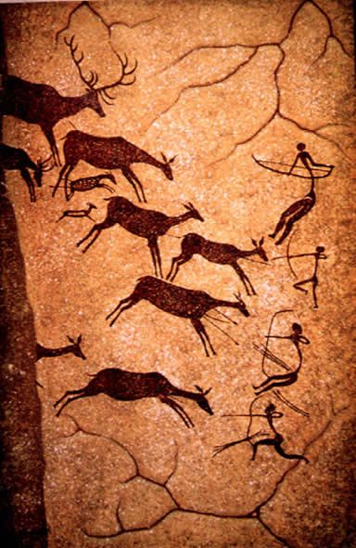
Cave Paintings
Cave paintings were used for many reasons.
They were used as a way to feeling a story.
They were used to identify each cave.
Painting animals was very popular in the painting.

