Slide 1
The Stone Age
Charlie and jacob

Slide 2
Stone Age Diets
Their Stone Age Diet Consisted mainly of Meat and Fish.
They would eat animals such as Deer, Bison And Woolly Mammoths.
They would also eat nuts and fruit where they can get it.

Slide 3
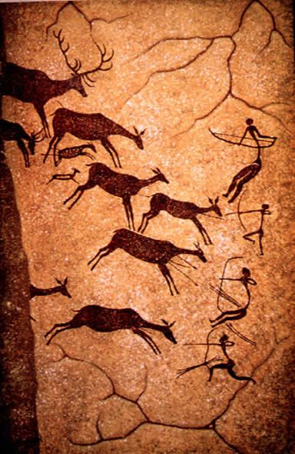
Stone Age Caves
Painting animals was very common in the Stone Age.
Paintings were made deep inside the caves and not where people lived, because flickering fire-light could have created the illusion that these paintings were real animals.
The famous cave paintings at Lascaux in france are 18000 years old.

Slide 4
Stone Age huts
Neolithic houses are more like our houses.
As a result, they built basic huts to live in and sleep in.
The huts were round and had fire in the middle to keep it warm.
They were made out of sticks and straw.

Slide 5
Cave Paintings
Cave paintings were used for many reasons.
They were used as a way of telling a story
They were also used to identify each cave
Painting animals was very popular in the paintings

